Slide 1

TRƯỜNG CAO ĐẲNG LÝ TỰ TRỌNG TP. HỒ CHÍ MINH

Slide 2

KHOA KHOA HỌC CƠ BẢN

Slide 3

ỦY BAN NHÂN DÂN THÀNH PHỐ HỒ CHÍ MINH
TRƯỜNG CAO ĐẲNG LÝ TỰ TRỌNG TP. HỒ CHÍ MINH
Bậc đào tạo: TRUNG CẤP CHUYÊN NGHIỆP
Tên giảng viên: LÊ NGUYỄN MỸ TRÂM

Slide 4
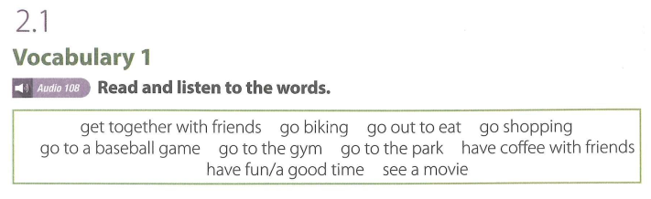

UNIT 2: FREE TIME ACTIVITIES

Slide 5
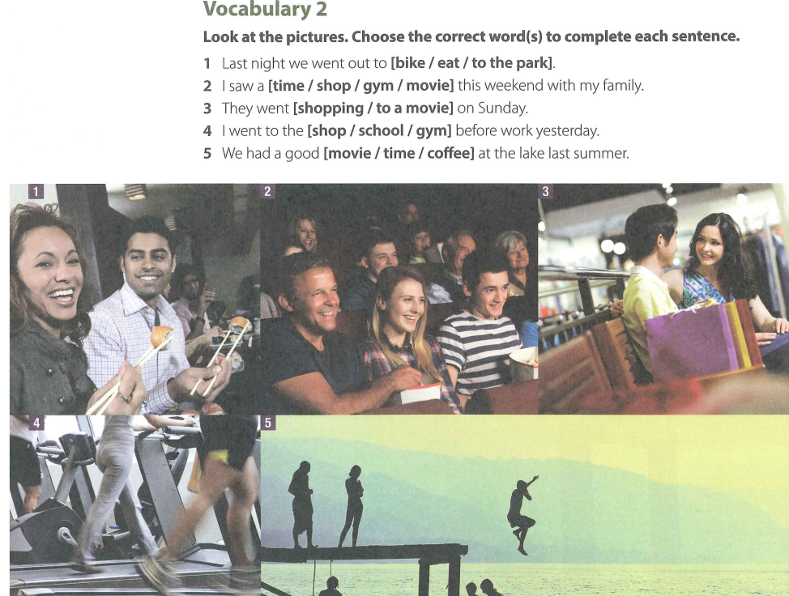

Slide 6
VOCABULARY 2 (KEY)
  Last night we went out to [bike / eat / to the park].
  I saw a [time / shop / gym / movie] this weekend with my family.
  They went [shopping / to a movie] on Sunday.
  I went to the [shop / school / gym] before work yesterday.
  We had a good [movie / time / coffee] at the lake last summer.

Slide 7
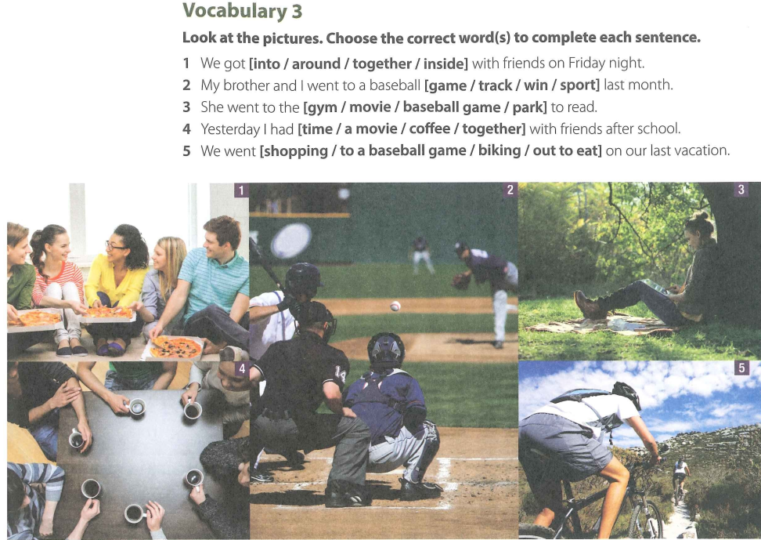

Slide 8
VOCABULARY 3 (KEY)
We got [into / around / together / inside] with friends on Friday night.
My brother and I went to a basebaII [game / track / win / sport] Iast month.
She went to the [gym / movie / baseball game / park] to read.
Yesterday I had [time / a movie / coffee / together] with friends after school.
We went [shopping / to a baseball game / biking / out to eat] on our last vacation.

Slide 9
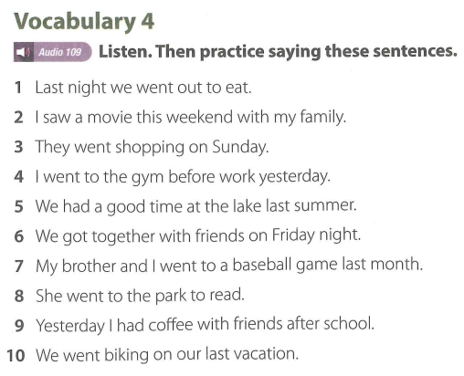

Slide 10
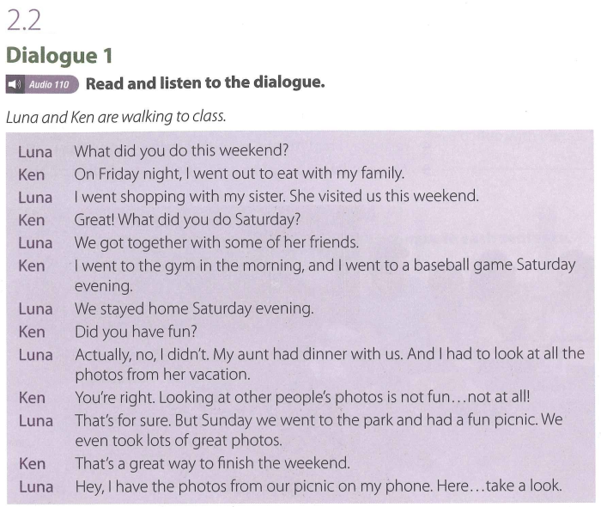

Slide 11
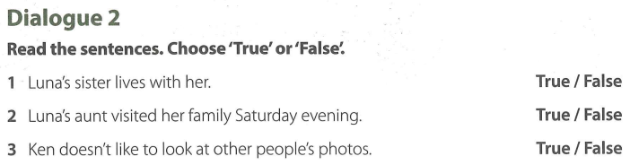

Slide 12
Dialogue 2 (Key)
1. Luna’s sister lives with her.
True / False
2. Luna’s aunt visited her family Saturday evening. True / False
3. Ken doesn’t like to look at other people’s photos.
True / False

Slide 13

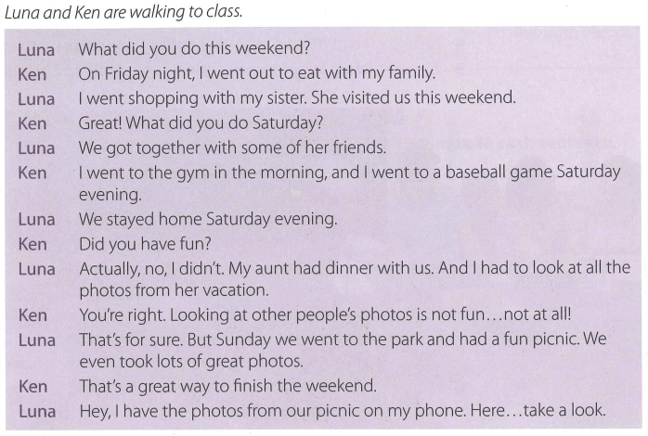

Slide 14
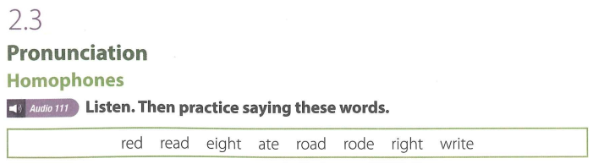

Slide 15
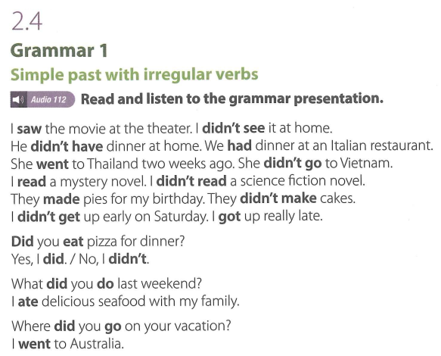

Slide 16
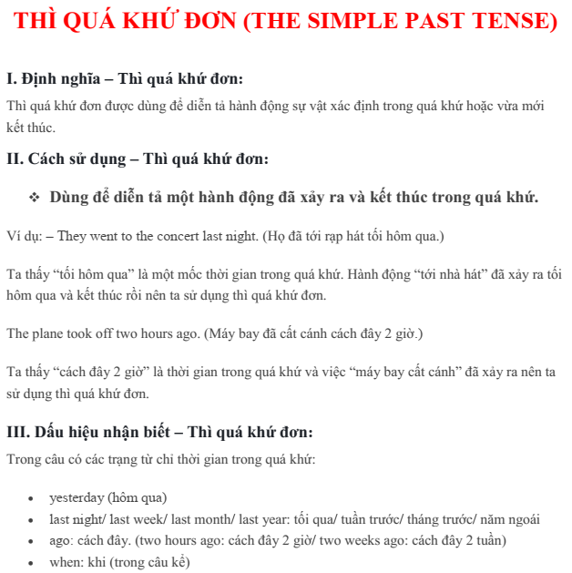

Slide 17
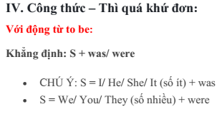
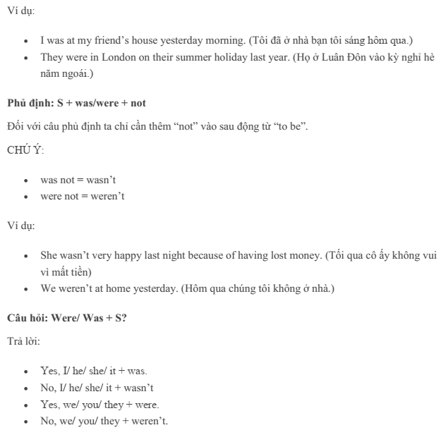

Slide 18
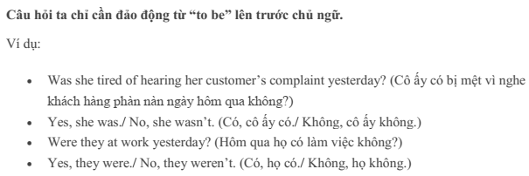

Slide 19
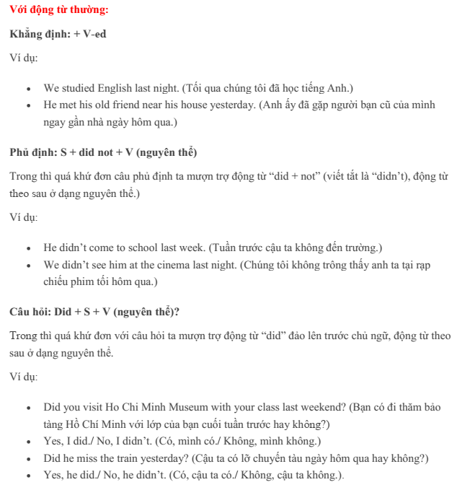

Slide 20
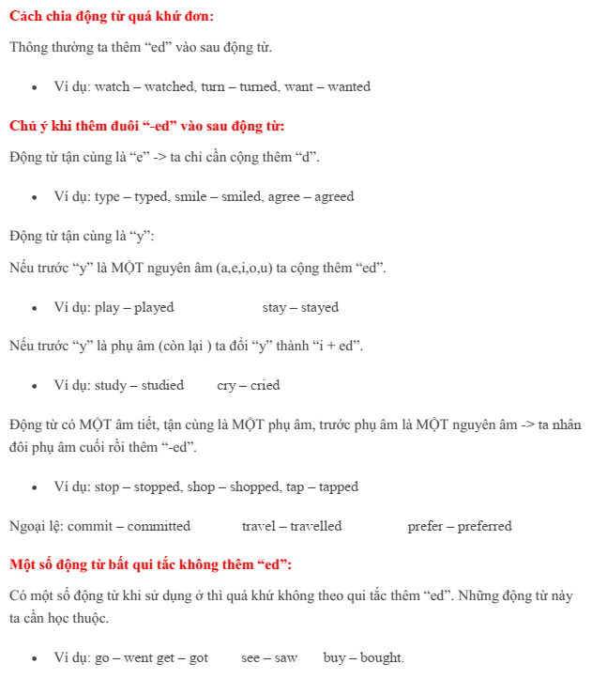

Slide 21
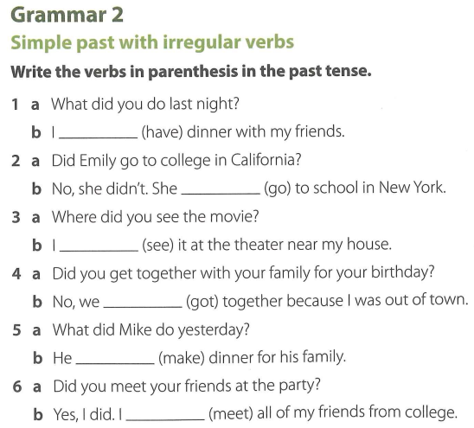

Slide 22
GRAMMAR 2 (KEY)
1. a. What did you do last night?
b. I had dinner with my friends.
2. a. Did Emily go to college in California?
b. No, she didn't. She went to school in New York.
3. a. Where did you see the movie?
b. I saw it at the theater near my house.
4. a. Did you get together with your family for your birthday?
b. No, we didn't get together because I was out of town.
5. a. What did Mike do yesterday?
b He made dinner for his family.
6. a Did you meet your friends at the party?
b Yes, I did. I met all of my friends from college.

Slide 23
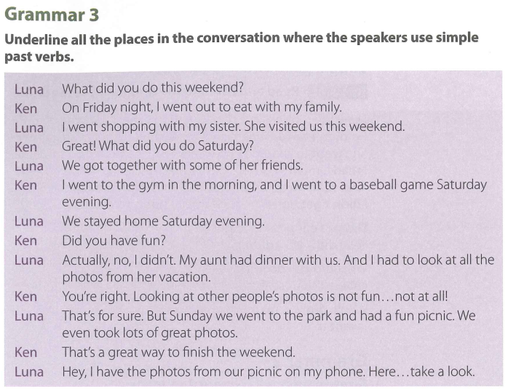

Slide 24
GRAMMAR 3 (KEY)
Luna: What did you do this weekend?
Ken: On Friday night, I went out to eat with my family.
Luna: I went shopping with my sister. She visited us this weekend.
Ken: Great! What did you do Saturday?
Luna: We got together with some of her friends.
Ken: I went to the gym in the morning, and I went to a baseball game Saturday evening.
Luna: We stayed home Saturday evening.
Ken: Did you have fun?
Luna: Actually, no, I didn’t. My aunt had dinner with us. And I had to look at all the photos from her vacation.
Ken: You’re right. Looking at other people’s photos is not fun...not at all!
Luna: That’s for sure. But Sunday we went to the park and had a fun picnic. We even took lots of great photos.
Ken: That’s a great way to finish the weekend.
Luna: Hey, I have the photos from our picnic on my phone. Here...take a look.

Slide 25
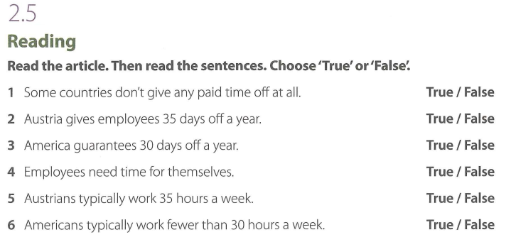

Slide 26
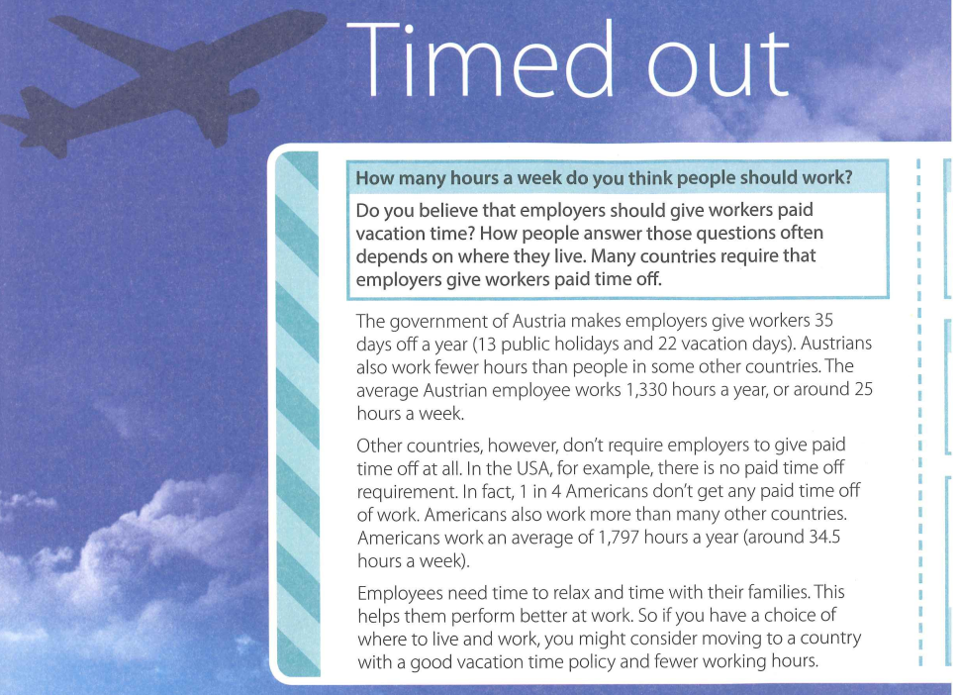

Slide 27
New words:
1. paid (adj): being given money for something:
2. depend /dɪˈpend/ (v): to be influenced or determined by something else:
Exs: All of this depends on how the test is constructed.
“Do you eat out at lunchtime?” “Well, it depends. I usually bring lunch, but sometimes I go out.”

Slide 28
New words:
3. require UK /rɪˈkwaɪər/ US /rɪˈkwaɪr/ (v): to need something or make something necessary:
Exs: Please call this number if you require any further information.
Skiing at 80 miles per hour requires total concentration.

Slide 29
New words:
4. government UK /ˈɡʌv.ən.mənt/ /ˈɡʌv.əm.mənt/ US /ˈɡʌv.ɚn.mənt/ (n): the group of people who officially control a country:
Exs: The government is/are expected to announce its/their tax proposals today.
The minister has announced that there will be no change in government policy.

Slide 30
New words:
5. employer UK /ɪmˈplɔɪ.ər/ US /ɪmˈplɔɪ.ɚ/ (n): a person or organization that employs people:
Exs: We need a reference from your former employer.
She was fired after she was caught stealing from her employer.
He gets paid a good wage, because he works for a fair employer.
I'm very lucky - I love my job and Geoff really is the ideal employer.

Slide 31
New words:
6. employee UK /ɪmˈplɔɪ.iː/ /ˌem.plɔɪˈiː/ US /ɪmˈplɔɪ.iː/ /ˌem.plɔɪˈiː/ (n): someone who is paid to work for someone else:
Exs:
If any employee needs to take time off, s/he should contact the Personnel Department.
Annabel has been a hardworking and responsible employee.
The police want to interview every employee about the theft.

Slide 32
New words:
7. Austrian UK /ˈɒ.striː.ən/ US /ˈɔː.striːən/ (adj): belonging to or relating to Austria or its people
8. Austrian UK /ˈɒ.striː.ən/ US /ˈɔː.striːən/ (n): a person from Austria

Slide 33
New words:
9. perform UK /pəˈfɔːm/ US /pɚˈfɔːrm/ (v): to do an action or piece of work:
Exs: Computers can perform a variety of tasks.
The operation will be performed next week.
Most of the students performed well in the exam.

Slide 34
New words:
10. consider UK /kənˈsɪd.ər/ US /kənˈsɪd.ɚ/
to spend time thinking about a possibility or making a decision:
Exs: Have you considered what you'll do if you don't get the job?
We're considering selling the house.
I'd like some time to consider before I make a decision.

Slide 35
New words:
11. policy UK /ˈpɒl.ə.si/ US /ˈpɑː.lə.si/ (n): a set of ideas or a plan of what to do in particular situations that has been agreed to officially by a group of people, a business organization, a government, or a political party:
Exs: They believe that Europe needs a common foreign and security policy.
What is your party's policy on immigration?

Slide 37
2.5 Reading (Key)
Some countries don’t give any paid time off at all. (True / False)
Austria gives employees 35 days off a year. (True / False)
America guarantees 30 days off a year. (True / False)
Employees need time for themselves. (True / False)
Austrians typically work 35 hours a week. (True / False)
Americans typically work fewer than 30 hours a week. (True / False)

Slide 38
Thank you very much
for
your cooperation.

